Slide 1
Visual data generation with GANs and its uses
Research Work
Muhammad Hashaam (B42621c)

Slide 2
Background of the Research
Object detection is crucial for self-driving technology.
Until a vehicle can accurately detect the objects on the road, it cannot be expected to drive safely.
One of the sensors to detect objects on the road are cameras.
Video signals from these cameras are used by the object detection algorithms to detect the objects on the road.
These algorithms are machine learning models that are pre trained on a large amount of visual data.
Obtaining the data for these models can be expensive, time consuming and biased

Slide 3
Purpose of the Research
Generating synthetic data to train the object detection algorithm.
Analyze the advantages and disadvantages of different models.
Testing the performance of different video generating algorithms.

Slide 4
Use Case
Decreasing the cost of gathering data for object detection algorithm.
Decreasing the time spent on gathering data.
Decreasing the bias in the data by increased variety of synthetic data.

Slide 5
What is deep learning
Deep learning models have
layers with weights W
Loss function L
Training means
Taking derivative dL/dW
updating weights through gradient descent
W=W-dL/dW

Slide 6
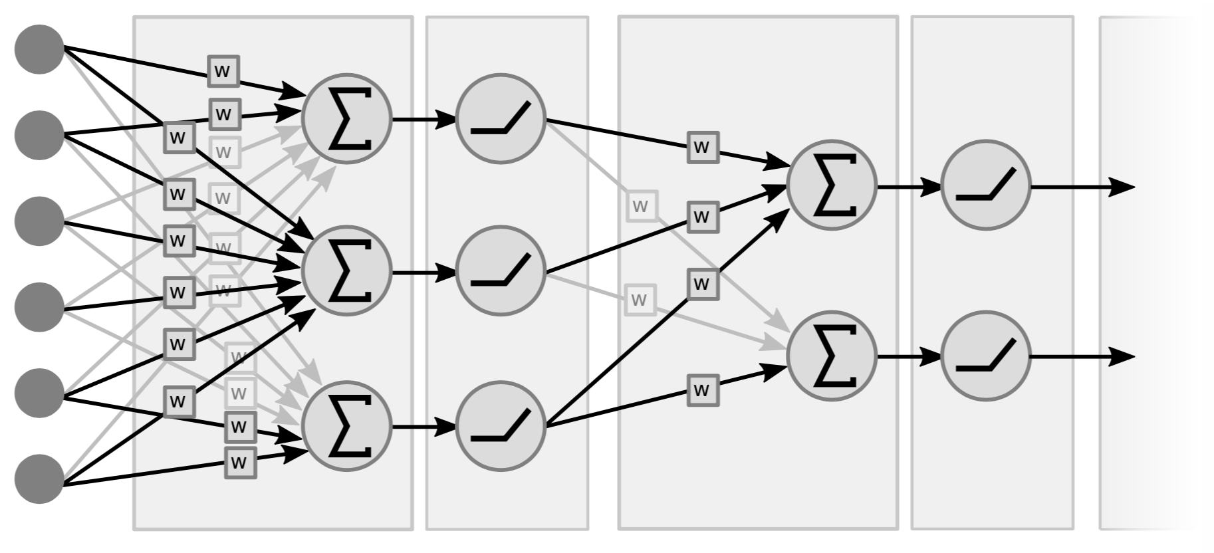
Classical Neural net
Matrix Multiplication
Nonlinearity
Loss calculation
Back propagation
Gradient descent
Update weight

Slide 7
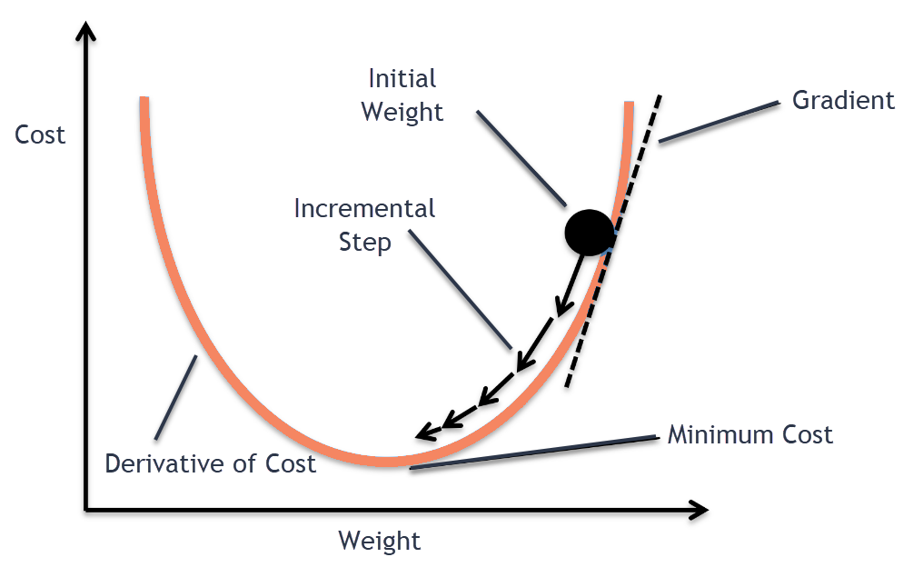
Gradient Descent

Slide 8
What are GANs
Generative Adversarial Networks (GANs) are deep learning methods in which:
Two neural networks contest with each other.
The two networks are generative which produces data, and discriminative which classifies the result.

Slide 9
Working
The generative model tries learn to important features of the data in such a way that it can be used to generate data that can pass for real data.
Discriminative model classifies produced data as real or fake.
Idea taken from game theory, players compete with each other and try to reach Nash equilibrium.
GANs have been applied to various domains such as time series synthesis, natural language processing and computer vision. In these domains, GANs can learn to mimic the distribution of data.

Slide 10
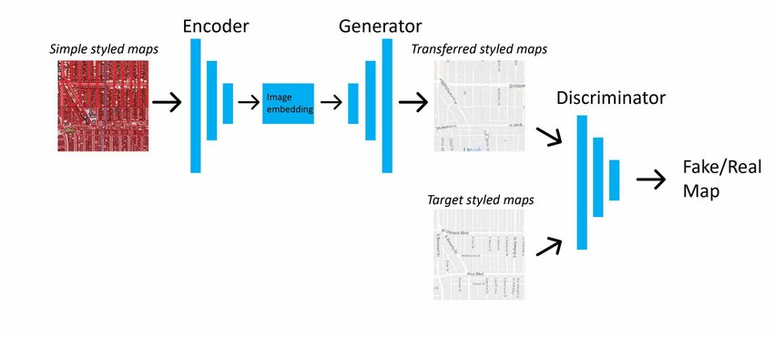
GANS for image translation

Slide 11
Types of Models
Lots of GAN models for image generation
Pix2Pix
Pix2Pix hd
Vid2Vid

Slide 12
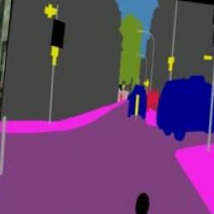
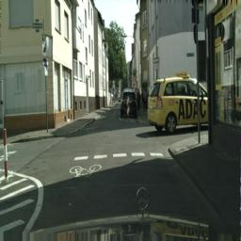
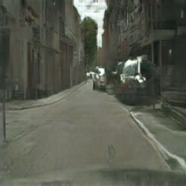
Image Translation Pix2Pix

Slide 13
Video generation
An input video can be mapped into an output video in a similar manner to image mapping. A video can be decomposed into frames and these frames can then be used to produce to output images. The output images are then combined to produce a video.

Slide 14
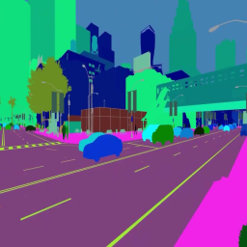
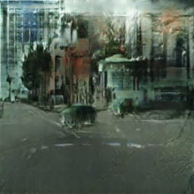
Issues

Slide 15

Consecutive frames with Pix2Pix

Slide 16
Consecutive frames with Pix2Pix

Slide 17
Problems with Pix2Pix for Video Translation
Frames are generated independantly, information does not flow from previous images to the next image.
This creates shaky images that do not transition smoothly.

Slide 18
Vid2Vid
This problem is solved by vid2vid GAN framework.
This framework uses information from previous frames in a video to generate a new frame.
By incorporating the information from previous frames, it maintains temporal consistency.
Loss =

Slide 19
Vid2Vid

Slide 20
Final Task
Testing object detection algorithms with synthetic videos shown above.

